Slide 1


Secure Note Android App with OAuth2
Course Project Presentation Presented by: Jannathbirdhouse Shahulhameed (801506774)
Course: ITIS 6200 U01- Prin Info Security & Privacy Date: 11/25/20225

Slide 2

Project Objective
Goal: To build a modular Android app that simulates secure note-taking using OAuth 2.0 token authentication and Postman mock APIs.
Why this project?
Demonstrates real-world authentication flow
Explores API simulation without a backend
Strengthens Android architecture and networking skills

Slide 3

Tech Stack
Layer Technology
Language Java
UI Android Fragments, ViewBinding
Networking OkHttp
JSON Parsing Gson
API Simulation Postman Mock Server
Token Storage SharedPreferences (TokenManager)

Slide 4

App Features
Secure Login with OAuth 2.0 Client Credentials Grant
View Notes via authenticated GET request
Add Notes with secure POST request
Logout clears token and resets session
Fragment-based navigation
Mock server integration for backend simulation

Slide 5
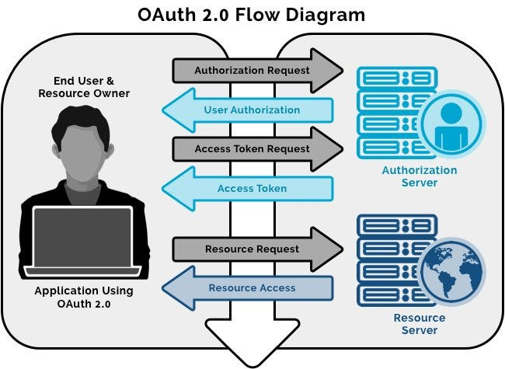
OAuth Flow Diagram:

Slide 6
OAuth 2.0 Flow Explained
1.End User / Resource Owner
This is the person using the app (e.g., Secure Note user).
They initiate the login or authorization process.
2. Authorization Request
The app sends a request to the Authorization Server asking for permission to access the user’s data.
This usually opens a login screen or consent form.
3. User Authorization
The user approves the request (e.g., logs in or grants access).
The Authorization Server confirms the user’s identity and permission.
4. Access Token Request
The app now asks the Authorization Server for an access token.
This token is a credential that proves the app has permission to access resources.
5. Access Token
The Authorization Server returns the token to the app.
This token is used in future API calls to authenticate the app.
6. Resource Request
The app sends a request to the Resource Server (e.g., to fetch notes, user data).
It includes the access token in the request header (usually as Authorization: Bearer).
7. Resource Access
The Resource Server validates the token.
If valid, it returns the requested data to the app.

Slide 7

App Flow Diagram
LoginFragment
↓ POST /oauth/token
TokenManager saves access_token
↓
NotesFragment
↓ GET /notes with Bearer token
ListView displays notes
↓
AddNoteFragment
↓ POST /notes with JSON
↓
Back to NotesFragment → Refresh notes
↓
Logout → Clears token → LoginFragment

Slide 8
Postman Mock Server
Base URL: https://b7e560ca-21d4-42c5-a603-50552c15ee5e.mock.pstmn.io
Endpoints:
POST /oauth/token → Returns static token
GET /notes → Returns note list
POST /notes → Simulates note creation
Matching Rules:
Auth header: Bearer abc123
POST body:
Json:
{ "title": "Note title",
"content": "Note content"
}

Slide 9

Project Structure
com.example.oauthsecurenoteapp
├── MainActivity.java - // Hosts fragments, entry point of app
├── LoginFragment.java - // Login screen
├── NotesFragment.java - // Notes list
├── AddNoteFragment.java - // Add new note
├── ApiService.java - // Networking (OkHttp + Gson)
├── TokenManager.java -// SharedPreferences for token
├── Note.java -// Model class
└── res/layout/
├── activity_main.xml
├── fragment_login.xml
├── fragment_notes.xml
├── fragment_add_note.xml
└── item_note.xml

Slide 10
Libraries and Tools Used
Tool/Library Purpose
OkHttp Sends HTTP requests (POST /oauth/token, GET/notes)
Gson Parses JSON responses into Java objects (Note.java)
ViewBinding Safely accesses views in fragments (no findViewById)
SharedPreferences Stores access token via custom TokenManager class
Postman Mock Server Simulates backend API responses without real server

Slide 11
How to Run the App
Clone the repo and open in Android Studio
Replace BASE_URL in ApiService.java
Run on emulator or device
Use any credentials to log in
View, add, and simulate secure notes

Slide 12
Learning Outcomes
Implemented OAuth 2.0 token-based authentication
Built OkHttp requests with error handling
Managed fragment lifecycle and UI updates
Designed stateless API simulation with Postman
Practiced modular architecture and clean code

Slide 13
Future Enhancements
Room DB for offline note storage
Swipe-to-delete with RecyclerView
Note editing and search functionality

Slide 14
Thank you ! Questions?

